Slide 1
Emojify
Create your emoji with Deep Learning
Aayush Manoj Tirmalle - 18BBTCS002
Aman.G.Nair – 18BBTCS008
Hemanth Kumar B – 18BBTCS042
K.N.Prajwal Sai – 18BBTCS046

Slide 2
Technology used
FER2013 Dataset
The FER2013 dataset ( facial expression recognition) consists of 48*48 pixel grayscale face images. The faces have been automatically registered so that the face is more or less centred and occupies about the same amount of space in each image.
The task is to categorize each face based on the emotion shown in the facial expression into one of seven categories (0=Angry, 1=Disgust, 2=Fear, 3=Happy, 4=Sad, 5=Surprise, 6=Neutral). The training set consists of 28,709 examples and the public test set consists of 3,589 examples.

Slide 3
CNN
In deep learning, a convolutional neural network (CNN, or ConvNet) is a class of deep neural network, most commonly applied to analyze visual imagery
Haar Cascade
Using OpenCV’s haar cascade xml we are getting the bounding box of the faces in the webcam. Then we feed these boxes to the trained model for classification.

Slide 4
Keras & TensorFlow 2
Keras is a deep learning API written in Python, running on top of the machine learning platform TensorFlow. It was developed with a focus on enabling fast experimentation.
TensorFlow 2 is an end-to-end, open-source machine learning platform. You can think of it as an infrastructure layer for differentiable programming
Keras is the high-level API of TensorFlow 2: an approachable, highly-productive interface for solving machine learning problems, with a focus on modern deep learning. It provides essential abstractions and building blocks for developing and shipping machine learning solutions with high iteration velocity.

Slide 5
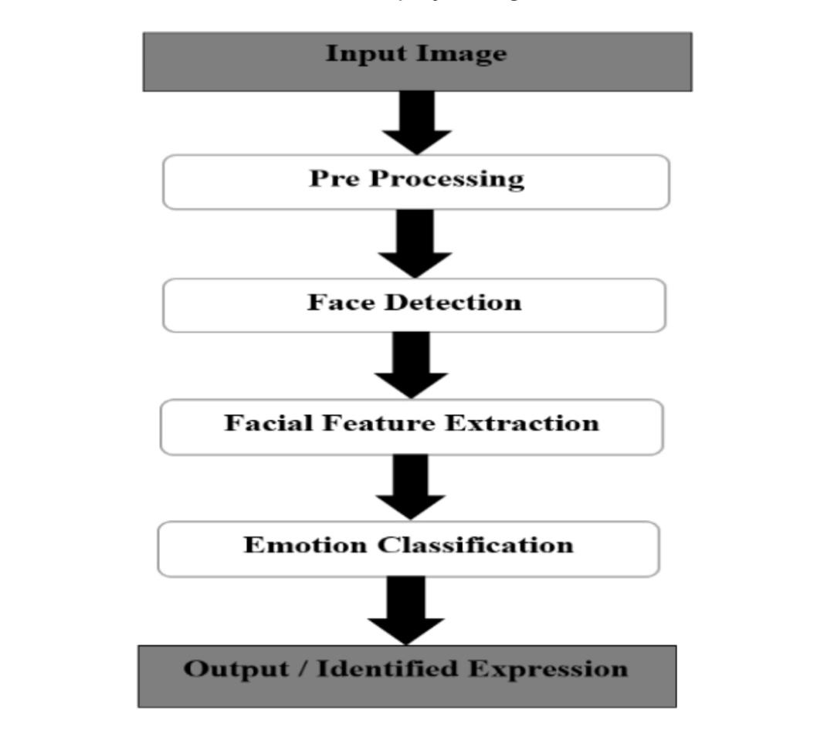
Workflow

Slide 6
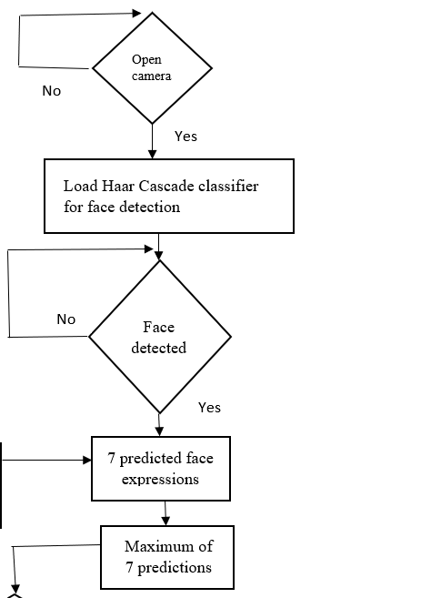
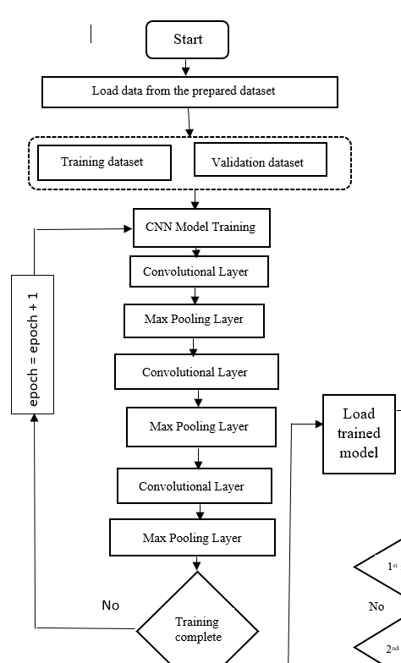
Flowchart

Slide 7
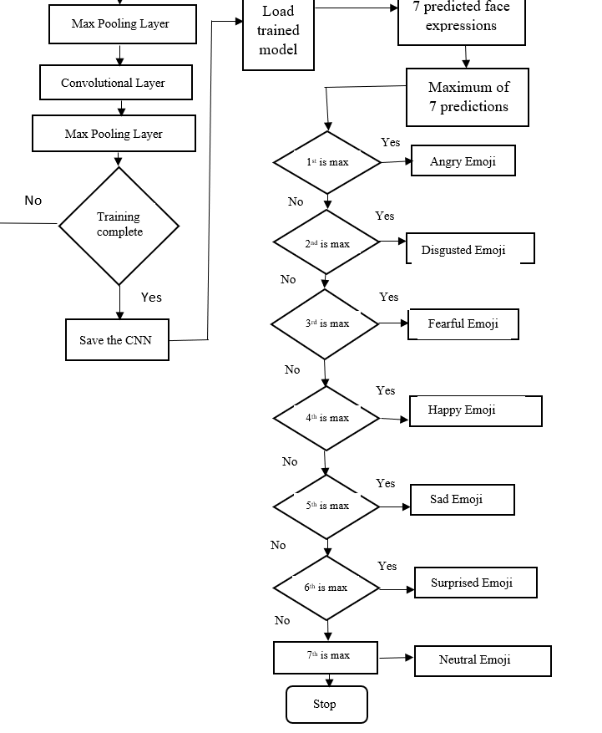

Slide 8
Pseudo-Code
Make a file train.py and follow the steps:
import numpy as np
import cv2
from keras.models import Sequential
from keras.layers import Dense, Dropout, Flatten
from keras.layers import Conv2D
from keras.optimizers import Adam
from keras.layers import MaxPooling2D
from keras.preprocessing.image import ImageDataGenerator

Slide 9
2. Initialize the training and validation generators:
train_dir = 'data/train'
val_dir = 'data/test'
train_datagen = ImageDataGenerator(rescale=1./255)
val_datagen = ImageDataGenerator(rescale=1./255)
train_generator = train_datagen.flow_from_directory(
train_dir,
target_size=(48,48),
batch_size=64,
color_mode="grayscale",
class_mode='categorical')
validation_generator = val_datagen.flow_from_directory(
val_dir,
target_size=(48,48),
batch_size=64,
color_mode="grayscale",
class_mode='categorical')

Slide 10
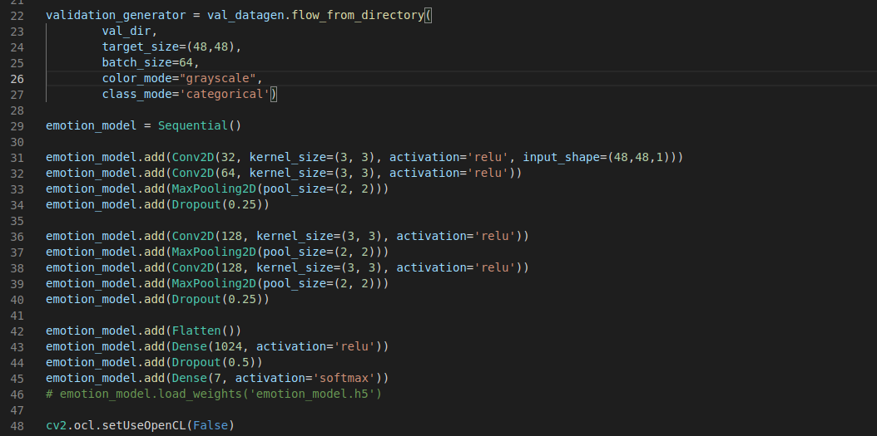
3)Build the convolution network architecture:

Slide 11
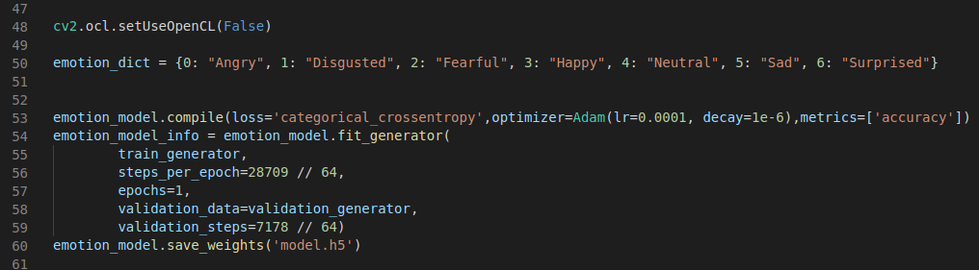
4)Compile and train the model:

Slide 12
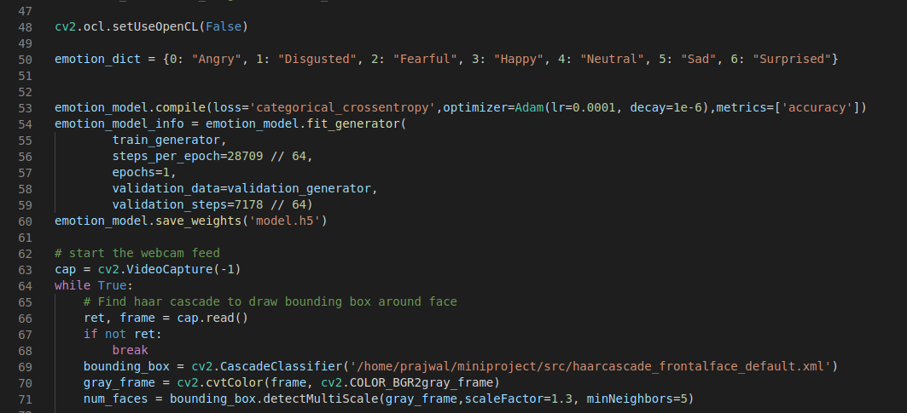
5. Save the model weights:
emotion_model.save_weights('model.h5')
6. Using openCV haarcascade xml detect the bounding boxes of face in the webcam and predict the emotions:

Slide 13
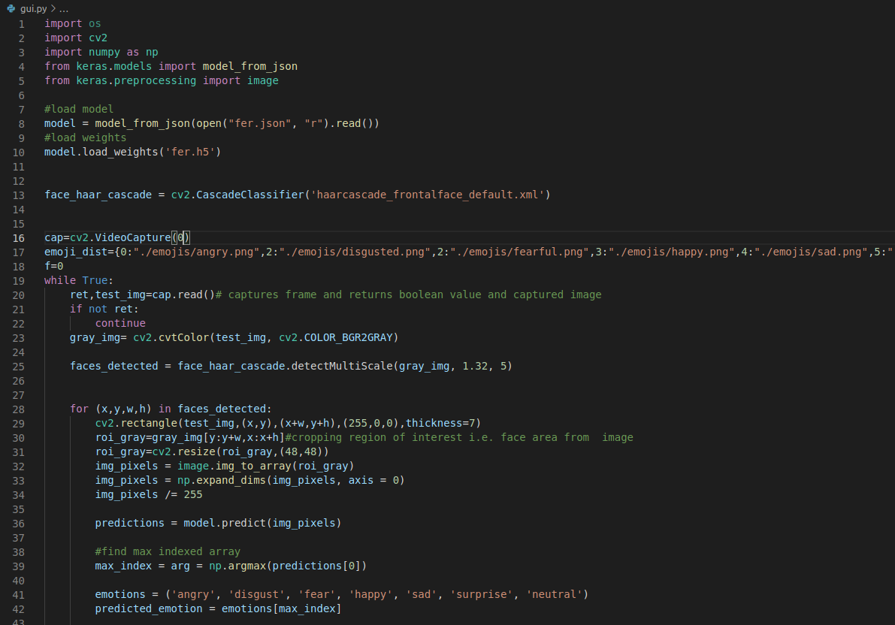
Code for GUI and mapping with emojis

Slide 14
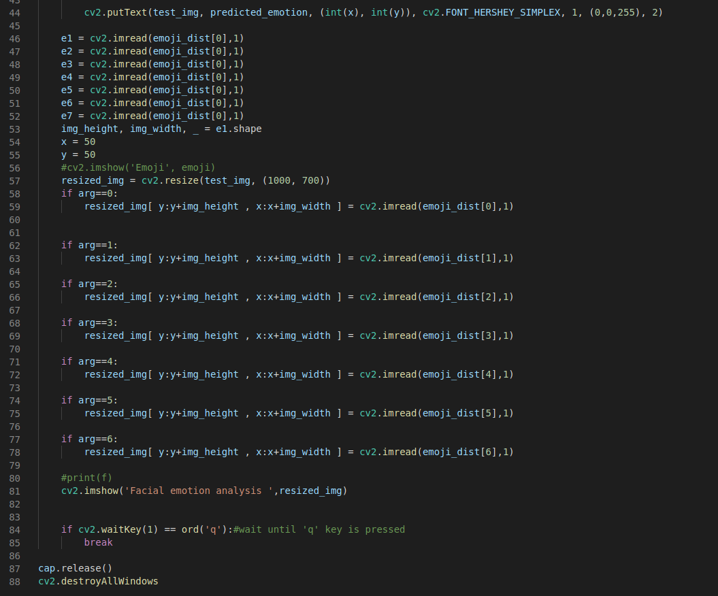

Slide 15
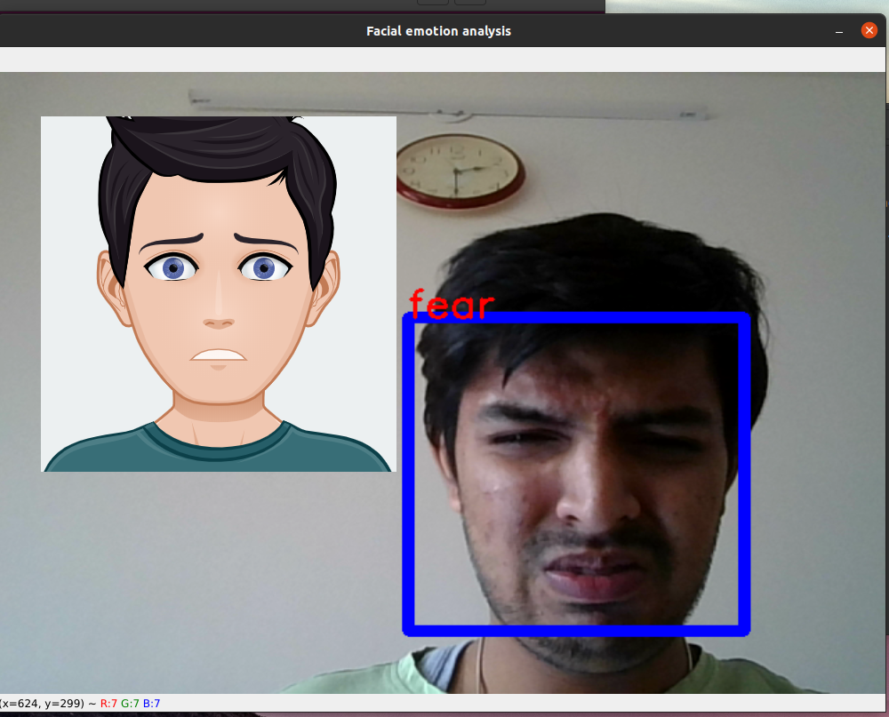
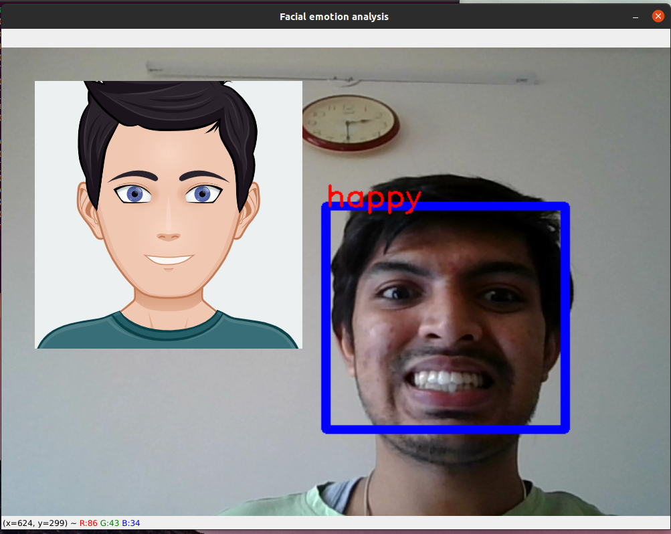
Results

Slide 16
Conclusion
In this deep learning project, we have built a convolution neural network to recognize facial emotions. We have trained our model on the FER2013 dataset. Then we are mapping those emotions with the corresponding emojis or avatars.
Using OpenCV’s haar cascade xml we are getting the bounding box of the faces in the webcam. Then we feed these boxes to the trained model for classification.

